Slide 1
School Leadership: Concept and Applications

Slide 2
Key Focus of the Module
Leading Learning: Improving Student Learning Outcomes
Understanding Leadership
School Leaders: Multiple roles and identities
Creating a Culture for Learning
Focus on leading by action
Building a practitioner’s perspective to leadership
Administrative Vs academic,
Organizational Vs Classroom specific
Role as academic leader – professional development of staff, developing learning environment, academic supervision and feedback
Promoting professional dialogue and learning, making reading, sharing, critiquing, learning a part of school time-table

Slide 3
Understanding Leadership

Slide 4
My School My Initiative (Activity 1 -10 Minutes)
Challenges in my School | My initiatives
I improved in … and my learning | I could’nt improve…… and my learning

Slide 5
My Initiatives- Record some good practices from your group(Discussion time 10 minutes)
Notes:
Adopting Students
Skill Development Program – Developed Content and Worked on teaching methods, Formed Clubs
Creativity- Bulletin Board
Lunch with indiscipline class
Uniform changes to motivate and compete with private school
Association with Boxing class
Take help from subject teachers from other schools
Decorative work (painting) in school to give good look
Find the ssues/problem of students through Personal Connect by spending time with every students, Emotional Support.
Admission of out of school students by removing documents formalities, open STC centers
Collaboration with private funders/NGO to improve school infrastructure

Slide 6
School Head: Multiple Roles and Responsibilities

Slide 7
What multiple roles do you perform on an average day?
In which role is your maximum time invested?
Identify 4 key areas where your maximum time in a day is spent
Make a pie-chart and plot the key roles on it.

Slide 8
School Leader: Multiple Roles and Identities (Activity 2-10 minutes)
Administrator
Manager
Liasoning Officer
Human Resource Manager
Academic Leader/Coach
Community mobilizer
Team Leader
Teacher
Examiner
Researcher
Reflect
Which of these roles contribute in improving teaching-learning in school
Or
Develop a learning culture in school?
How do I manage time between different roles?
How do I contribute more towards improving learning in school?

Slide 9
Researches on role of leadership in improving SLO

Slide 10
10 Essentials for Heads of Schools
Most school variables, considered separately, have at most small effects on learning. The real payoff comes when individual variables combine to reach critical mass. Creating the conditions under which that can occur is the job of the principal. (Wallace Foundation, 2011, p. 2)

Slide 11
Contd.
Supporting teachers improve their teaching,
Using data to review and refine the instructional program
Ensuring that the schools are kept clean and safe.
Shaping a vision of academic success for all students in all schools, one based on high standards through school networks. (Role for system officials)

Slide 12
Contd.
Creating a climate hospitable to education in order that safety, a cooperative spirit and other foundations of fruitful interaction prevail.
Cultivating leadership in others so that teachers and other adults assume their part in realizing the school vision.
Managing people, data and processes to foster school improvement. (Wallace Foundation, 2011, p. 4)

Slide 13
Contd.
Enhancing the skills and knowledge of the people in the organization,
Creating a common culture of expectations around the use of these skills and knowledge,
Holding the various pieces of the organization together in a productive relationship with each other, and
Holding individuals accountable for their contributions to collective result. (Elmore, 2000 p. 7)

Slide 14
Being an Instructional Leader

Slide 15
What is Instructional Leadership?
managing curriculum
setting clear goals
monitoring lesson plans
involving colleagues collaboratively in mutual learning and development
allocating resources
evaluating teaching regularly
improve student learning and teacher effectiveness
Notes:
Instructional leadership is generally defined as the management of curriculum and instruction by a school principal. This term appeared as a result of research associated with the effective school movement of the 1980s, which revealed that the key to running successful schools lies in the principals' role.

Slide 16
What is Instructional Leadership?
Learning-focused
Addressing cultural, linguistic, socioeconomic and learning diversity in the school community
Engaging in Learning rounds and Learning Conversation
Improving instruction and quality of student learning
Developing a culture of public practice and reflective practice
Notes:
Instructional leadership is generally defined as the management of curriculum and instruction by a school principal. This term appeared as a result of research associated with the effective school movement of the 1980s, which revealed that the key to running successful schools lies in the principals' role.

Slide 17
Roles of an Instructional leader (IL)
Based on the above understanding of an instructional leader – Infer the roles of an instructional leader
Make a list of all the roles of IL (Activity 3- 10 minutes)
Of these list of roles – which roles do you perform?

Slide 18
Activity4 (20 minutes) – Individual followed by Small Group Discussion
Reflect on how you would become an instructional leader in your context
Entry point – what do you practice currently and where do you want to improve?
Process/Mechanism – what new mechanisms you would have to initiate
Assessing progress – How do you assess change in self, others and processes
Potential Challenge
How would you transform teaching learning in CR as an instructional leader?

Slide 19
Improving Classroom Observation and Feedback
Why conduct classroom observation?
Is CrO always about a senior observing a junior or could it be otherwise as well?
What are the challenges in CrO?
What would be the role of School head/CRC/BRC in CrO?

Slide 20
Activity 5- 20 minutes
Ask participants to give their observations on the facilitator’s class
Record all the observations on board
Seek feedback from all on the session that they have been observing
Ask them to find out the difference between observation and feedback
Underline all observations loaded with opinions, judgments, adjectives or negatives and positives and separate them from objective descriptive statements

Slide 21
Also underline all the statements in the feedback which were either positive, negative or in any way evaluative or judgmental
Discuss the pro-cons of giving opinionated observations and feedback
Explain the difference between observation and feedback

Slide 22
What is Classroom Observation?
Observation is an objective description of all that one perceives through senses – see, hear and feel.
Observation does not include opinion, perception, evaluation or judgment.
It is neither positive nor negative
It therefore begins with statements like:
I saw……
I heard…..
I felt……
I noticed……
I observed……

Slide 23
What is feedback?
The word feedback is a combination of two – FEED and BACK, literally to mean giving back what is given to you….. Such that it makes the person think and reflect on what one has given.
Feedback therefore cannot be opinionated
Feedback is once again neither positive nor negative
It is neither advisory nor suggestive
It is also not evaluative or judgmental
Feedback has to be REFLECTIVE and is for IMPROVEMENT

Slide 24
Developing a Learning Culture

Slide 25
What is a Learning Conversation (LC)?
LC happens after lesson observation where the observer strictly limits to describing the teaching-learning process thus stimulating reflective thought based on the evidence.
It does not indulge into praise or criticism.
It is a formative process to help the teacher have a deeper understanding of the teaching-learning process.

Slide 26
Contd.
Deeply empowering as teacher develops confidence in their own ability to improve their practice.
It replaces the traditional ‘Praise-Criticism-Praise’ sandwich model to ‘Ask-Describe-Ask’ process
Emphasis is on observers’ learning and expectation isn't that the group will solve the problem, but that observers will come away with a clearer picture and new ideas about next steps.

Slide 27
Premise/Principle
“Privacy of practice leads to isolation and isolation is the enemy of improvement.” – Elmore
It is not a deficit model, designed to spot flaw or failure .
Stress is on not ‘critiquing’ an individual but collecting episode so that we can see patterns.

Slide 28
Ask-Describe-Ask Process
Ask – The observer asks the observee for his/her reflections
What were his/her goals around chosen focus area?
What went well and what could have gone better?
Asking enables the observer
to start a dialogue
Ensures the colleague is heard
Is useful for tailoring feedback
Puts the focus on the learning of the colleague

Slide 29
Continue
Describe – the observer describes what he/she saw
Gives descriptive information to the colleague on the chosen focus area
Responds to the colleague’s view on the lesson
Gives feedback on the observee’s own self-assessment
Uses phrases like “I observed….” or “the following evidence is …..” or “the pupil said…..”
It creates a description of what you saw and lays the platform for a discussion about learning and teaching.

Slide 30
Continued
Ask (again) – the observer asks about understanding and next steps
What is our learning?
What new understandings have we developed?
What could the observed colleague do differently?
What could be the next few steps?
How do we monitor improvement together?

Slide 31
Praise-Criticism-Praise model
“You did well and I felt that you kept a tight rein on behavior. However , thought your questioning style was limited and very biased towards the boys. Overall, I enjoyed the lesson.”
This model is overly reliant on a judgmental ‘tell’ approach that has the observer ‘telling’ the observee what and how to improve
The challenge for the teacher is in trying to unpack what is being said.
If there is lack of trust or hesitation, an effective learning conversation becomes impossible.

Slide 32
Ask-Describe-Ask model
“At the stage where you engaged with children in question and answer, you posed 12 questions on the topic, nine of the questions were closed ended and ten of the question were posed only to boys. I’m interested in your thinking on this?”
It is a shift from top-down approach to an approach between two individuals involved jointly in a learning enquiry.
There is no judgment, the observer gives descriptive feedback designed to stimulate reflective thought.
Learning conversation here might focus on ‘closed questions’ used to scaffold learning towards more open-ended questions or ‘questions only to boys’ or lower order questions.
Emphasis here is on coaching style rather than telling style.

Slide 33
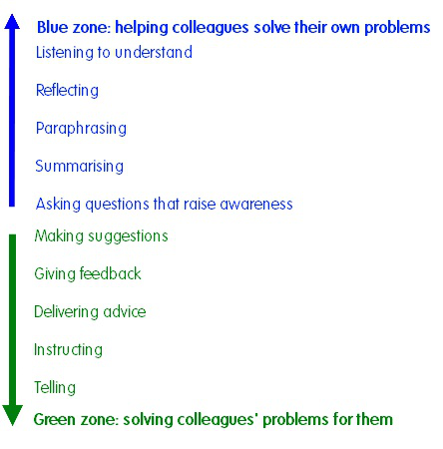
Role of instructional leader

Slide 34
Why engage in learning conversations?
Maximize teacher potential
Create opportunity to reflect on their skills
Identify ways to developing self
Improve performance
Provides constructive challenges
Provides opportunities to explore ideas
Helping them be self-aware, take responsibility for self-growth and development.

Slide 35
Creating a Learning Culture
How do you make learning conversations a regular feature of your school?
What opportunities does your school currently offer for teachers to come together and learn?
Is reflection a part of practice, time – table or calendar?
Should reflective practice be introduced in school?
How would reflexivity change the school culture?

Slide 36
Activity 3: Role Play (30 minutes)
Divide the large group into five small groups
Let us assume that you all belong to one school
Now pick up one challenge that the school wants to overcome through collaborative learning and reflection
Let this be a demonstration of an ideal staff/cluster/block meeting that focuses on learning
Set an agenda, allot equal time to each speaker, allot responsibility to one member for recording minutes, make common meeting ethics/norms
Bring out probable solutions and share it with larger group

Slide 37
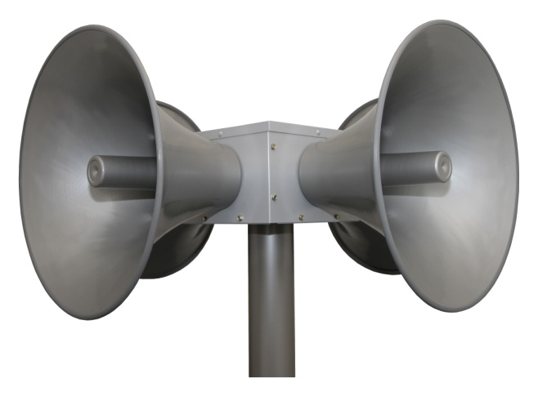
How do you sustain learning?
THINK | SHARE | ACT
How do you lead school improvement through reflective dialogue and collaborations? | Share your knowledge, ideas and exposure with others and encourage and empower them to spread the word | Change your practices, habits and develop self sustaining teams through appreciation, support and role modelling

